Slide 1
Cover Crops for Soil Health:
Class Introduction
NRCS Soil Health Division
Lockeford Plant Materials Center
April 2024
Notes:
Insert Photo
This module will introduce some basic concepts in cover cropping and soil health and introduce the scope of the three day training.

Slide 2
Why do producers plant cover crops?
What are they hoping to achieve on their farms with the practice?
Notes:
Ask these questions to the participants and take several responses.

Slide 3
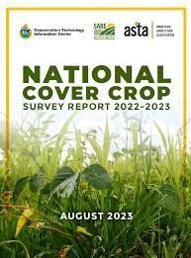
Background – National Cover Crop Survey
National Cover Crop Survey Report
  Conservation Technology Information Center, USDA SARE, and American Seed Trade Association.
  2022 – 2023 report published Aug. 2023
795 respondents from across U.S. and across scales of agriculture.
Acres planted to cover crops (CCs) reported by respondents has grown steadily between 2012 – 2022.
https://www.sare.org/wp-content/uploads/2022-2023-National-Cover-Crop-Survey-Report.pdf
Notes:
This is the national cover crop survey report. This report is a great resource of information about how producers are using cover crops across the country.
The point that the survey contains 795 responses from across the U.S. and all scales of farming is key.

Slide 4
Background – National Cover Crop Survey:
Producer Goals for using CCs
Top Five Motivations in the Survey
Improve soil health (95%).
Add soil organic matter / sequester C (91%).
Improve water infiltration (82%).
Reduce erosion (81%).
Improve weed management (79%).
Notes:
The national cover crop survey begins with the question of "What are producers' goals for using cover crops on their farms?"
The top five motivations reported in the survey are listed here. "Improving soil health" was the most commonly reported motivation for using cover crops. The second, third, and fourth most common responses are also closely tied to soil health. The fifth most common response was to "improve weed management" and many people consider that to be closely related to soil health.
Clearly producers across America are hoping to improve their soil health by using cover crops.

Slide 5
Background – National Cover Crop Survey:
Financial Assistance
49% of respondents who planted cover crops in 2022 reported receiving some form of financial assistance.
Cover crops were the conservation practice that received the most funding from the NRCS Environmental Quality Incentives Program (EQIP), nationally between 2017 – 2020.
Among those in the survey receiving payment, 90% reported they would either “definitely” or “probably” continue planting cover crops after their incentive program.
Notes:
This slide contains information about financial assistance and cover crops from the survey and should be of interest to NRCS staff and some partner organizations. About half of producers that responded that they were using cover crops also reported that they were using cover crops as part of a financial assistance program.
Also on a very positive note in this area, 90% of these producers reported that they would either definitely or probably continue using cover crops after the end of their incentive program.

Slide 6
Question to audience
Do you consider cover crop management to be a complex topic?
Notes:
Ask the group this question and take several responses. Yes it is complex, because you have to know the context of the farm and climate, growing conditions, goal and objectives of the farmers; know how to select the CCs and build the mix, etc.

Slide 7
Cover Cropping Outcomes
Are these outcomes guaranteed?
What kinds of factors determine these outcomes?
Top Five Motivations in the Survey
Improve soil health (95%)
Add soil organic matter / sequester C (91%)
Improve water infiltration (82%)
Reduce erosion (81%)
Improve weed management (79%)
Notes:
Building on the previous question about complexity, ask the participants these two questions.
Are the outcomes that producers are looking for from cover crops a gaurantee? Unfortunately, they are not a guarantee – at least not all of them and not in every farming situation or soil. Cover cropping CAN be a complex topic and activity and there are many site specific factors that contribute to the outcomes associated with cover cropping.

Slide 8
Research on Cover Crops and Soil Health:
Reviewing research reviews
Notes:
In this next section of this presentation we will take a look at a lot of recent research articles related to cover cropping and soil health to see what the data say about farmers desired outcomes.
We will focus on review articles. Review articles look at many different studies on the same topic. Research reviews generally have guidelines about how the studies that they include were conducted, so that they were all done in a way that allows them to be compared.
By focusing on review articles here, we are capturing a synthesis of many studies that have been done on cover cropping and soil health. The articles included in this presentation are mostly focused on studies conducted in the U.S. It is good to know the research on CCs. However, we should pay close attention to SH innovators in our states and regions to see how they implement SH principles on their farms. Several modules in this training have good of supporting literatures.

Slide 9
What does research synthesis suggest about CC goals?
Top 5 Producer Goals for CCs | Research Reviews Indicate
1. Improve Soil Health | Yes – consistent change in biological properties, some change in physical properties. Incremental
2. Add soil organic matter / sequester C | Inconsistent – dependent on management and site conditions and duration of studies
3. Improve water Infiltration | Yes – More published research needed on topic
4. Reduce erosion | Yes – very consistent results
5. Improve weed management | Yes – very consistent, depending on management
Notes:
We were able to find research review articles that focused on all of the topics on our initial list here and provided fairly conclusive information.
Starting with the most consistent results – research certainly supports the idea that cover cropping both improves weed management and reduces soil erosion. There are very consistent research results that indicate cover crops can drive these changes for producers.
Also consistent, but perhaps less sure fire are results that suggest that cover crops improve water infiltration and improve soil health. The available studies DO demonstrate that cover crops improve water infiltration in soils – this is also supported by many many observations from NRCS staff. Surprisingly, however, there simply are not very many published studies that look at cover crops and water infiltration. Cover crops effects on soil moisture is a key area where more research would be helpful.
There are many studies that support the idea that cover crops improve soil health. The results are particularly good for making short term changes in soil biology, we see the abundance of soil microbes consistently increasing in soils with cover crops. Published research also supports that cover crops can improve some physical properties of soil and this again is an area where there is not currently a lot of published data. Changes from cover crops on soil health can be described as incremental, meaning that the changes are greater the longer that the producer uses cover crops.
Lastly, the goal of increasing soil organic matter was the least consistent in the published research on cover crops. This is an area where cover crops become a complex topic and there are a variety of factors at play. We will take a closer look at this topic.

Slide 10
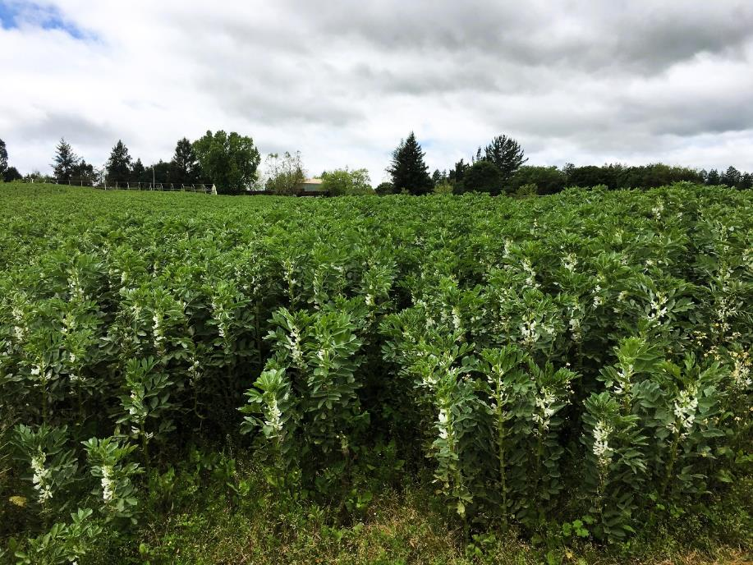
Cover Crops and Soil Carbon
Review of 35 studies from across U.S. that had CC vs No CC treatments
  Measured SOC or SOM
  Did not apply supplemental nutrients to CC
35 studies contained 77 comparisons – CC vs No CC
Cover cropping resulted in SOC accumulation in 29% of comparisons (22 out of 77)
Photo: J. Beniston, USDA NRCS
Source: Blanco-Canqui, 2022
Notes:
A recent review article on the topic of cover crops and soil carbon sequestration provides some interesting insights into the complexities of cover crop management and soil health outcomes. Major finding is that across 35 studies and 77 comparison, only 29% of the comparisons had results that showed an increase in soil carbon.
Good to ask the participants "Why might this be? or What do you think of this result?"
Source for this slide:
Blanco‐Canqui, H. (2022). Cover crops and carbon sequestration: Lessons from US studies. Soil Science Society of America Journal, 86(3), 501-519.
https://acsess.onlinelibrary.wiley.com/doi/abs/10.1002/saj2.20378
However, in another meta analysis from the same author suggested that Cover crops accumulated SOC in 59% of comparisons and on effect on 41% of the literature cited, and no negative effects of CC on SOC.
Source of this slide:
Blanco-Canqui, H. et al. (2021)
https://acsess.onlinelibrary.wiley.com/doi/10.1002/saj2.20335

Slide 11
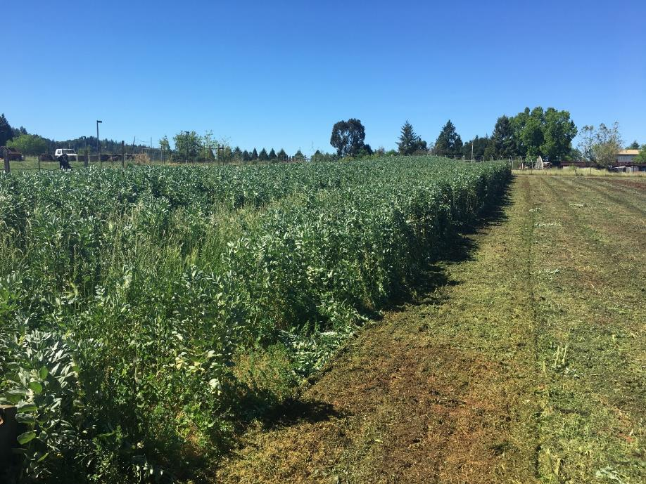
Factors affecting SOC accumulation with Cover Crops
Amount of CC Biomass
  No studies reporting SOC gains with CC biomass < 1 ton per acre
  70% of studies with >2.5 tons CC biomass per acre report gains in SOC
Number of years planting cover crops
  Highest rates of SOC accumulation observed in sites planting CCs for 5 – 10 yrs
Trend of increased SOC accumulation rates in sites with lower initial SOC (<1%)
No observed differences in CC mixes vs single species.
Planting a mix can increase biodiversity and can insure against weather extremes. Source: UNL 2020
Source: Blanco-Canqui, 2022
Photo: J. Beniston, USDA NRCS
Notes:
The review found that increases in soil carbon from cover cropping were very dependent on management practices and site conditions. This slide covers some of the major factors that contributed to observations of increasing soil carbon. There were two management related factors that had a big impact on soil carbon accumulation in soils.
The amount of cover crop biomass. Sites with a lot of biomass were much more likely to see increases in soil carbon. So this could be challenging in some climates, management systems, or even certain years when planting or termination was late or early.
The number of years that a producer had used cover crops was a second major factor. Farms that had used cover crops for 5-10 years had the highest rates of SOC accumulation. SOC gains were generally low on farms that had been using cover crops for less than five years.
Finally, SOC accumulation was increased at sites that started out with low initial SOC.
Source for this slide:
Blanco‐Canqui, H. (2022). Cover crops and carbon sequestration: Lessons from US studies. Soil Science Society of America Journal, 86(3), 501-519.
https://acsess.onlinelibrary.wiley.com/doi/abs/10.1002/saj2.20378
However, we cannot rely on one study. Many literature suggested that mixed cover crops have many benefits including SOC over single spp cover crops.
By Katja Koehler-Cole - Extension Educator, Fernanda Souza Krupek – Agronomy Graduate Research Assistant, Chris Proctor - Weed Management Extension Educator, Andrea Basche – Associate Professor UNL 2020
Advantages of diverse mixes
Experiments of mixed versus monocultured plant species have demonstrated that plant mixtures can produce greater plant biomass (DeBell et al., 1997; Forrester et al., 2004), and improve nutrient cycling and soil fertility (Binkley et al., 1992, 2000; Bauhus et al., 2000; Montagnini et al., 2000). The increase in plant biomass in the mixture may have strong effects on soil microbial community.
2024 Productivity benefits of cereal-legume cover crop mixtures under variable soil nitrogen and termination times
Author links open overlay panel Patricia Moreno-Cadena 1, Montserrat Salmeron, Lucas Pecci Canisares, Hanna J. Poffenbarger
https://www.sciencedirect.com/science/article/pii/S1161030124000352

Slide 12
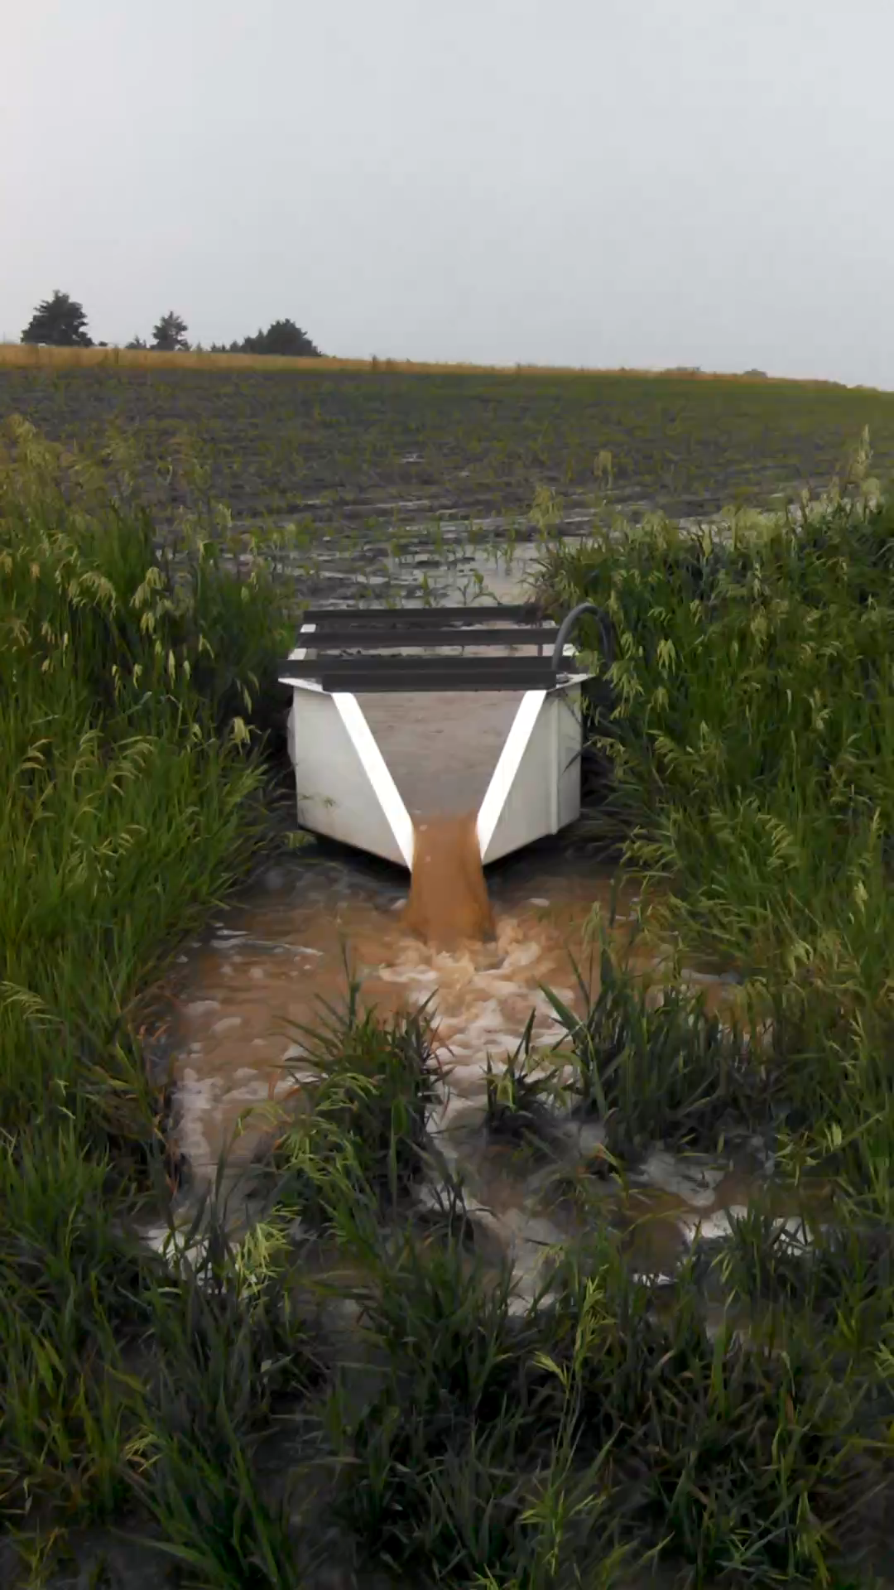
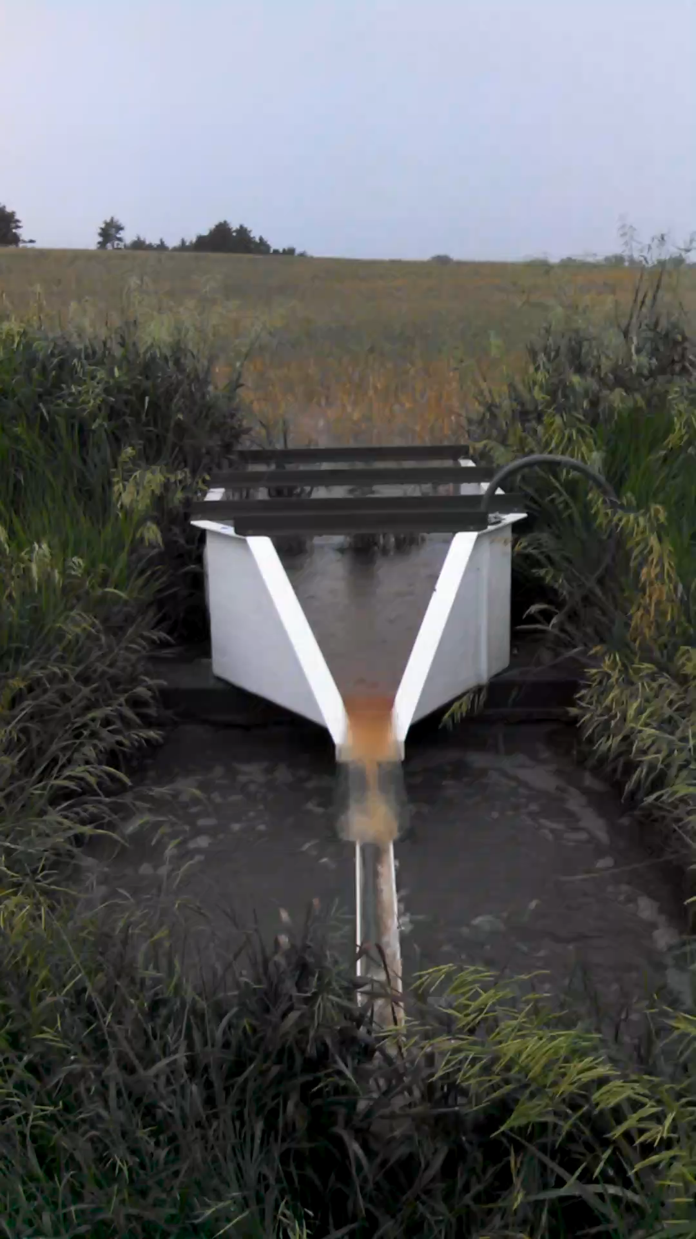
Cover Crops and Water Quality
Videos are taken at the same site, same time.
Only difference was a triticale and rapeseed cover crop.
Videos used with permission by Dr. Nathan Nelson
Notes:
These videos provide a great visual demonstration of the impact of cover crops on soil erosion and water infiltration. The video on the left side of the screen is a fallow field without any cover crop. The video on the right is a field that has a winter cover crop of triticale and rapeseed.
Ask participants what they think of the videos.
Consider adding Kabir's video of cover crops and no cover crops orchard

Slide 13
References
Abdalla, M., Hastings, A., Cheng, K., Yue, Q., Chadwick, D., Espenberg, M., ... & Smith, P. (2019). A critical review of the impacts of cover crops on nitrogen leaching, net greenhouse gas balance and crop productivity. Global change biology, 25(8), 2530-2543.
Blanco‐Canqui, H. (2018). Cover crops and water quality. Agronomy Journal, 110(5), 1633-1647.
Blanco‐Canqui, H. (2022). Cover crops and soil ecosystem engineers. Agronomy Journal, 114(6), 3096-3117.
Blanco‐Canqui, H. (2022). Cover crops and carbon sequestration: Lessons from US studies. Soil Science Society of America Journal, 86(3), 501-519.
Blanco‐Canqui, H., & Ruis, S. J. (2020). Cover crop impacts on soil physical properties: A review. Soil Science Society of America Journal, 84(5), 1527-1576.
Hao, X., Abou Najm, M., Steenwerth, K. L., Nocco, M. A., Basset, C., & Daccache, A. (2023). Are there universal soil responses to cover cropping? A systematic review. Science of The Total Environment, 861, 160600.
Kim, N., Zabaloy, M. C., Guan, K., & Villamil, M. B. (2020). Do cover crops benefit soil microbiome? A meta-analysis of current research. Soil Biology and Biochemistry, 142, 107701.
Osipitan, O. A., Dille, J. A., Assefa, Y., Radicetti, E., Ayeni, A., & Knezevic, S. Z. (2019). Impact of cover crop management on level of weed suppression: a meta‐analysis. Crop Science, 59(3), 833-842.
Tautges, N. E., Chiartas, J. L., Gaudin, A. C., O'Geen, A. T., Herrera, I., & Scow, K. M. (2019). Deep soil inventories reveal that impacts of cover crops and compost on soil carbon sequestration differ in surface and subsurface soils. Global change biology, 25(11), 3753-3766.
Notes:
This is a list of the articles that were used to compile this presentation and the table on soil health outcomes. These are all good references for people who would like to look deeper into these concepts. We need to add more relevant references related to the subject.

Slide 14
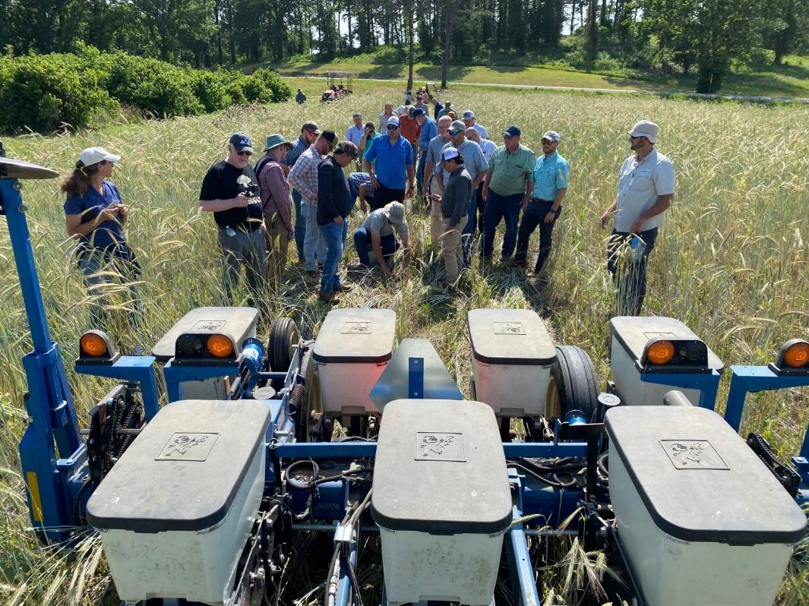
Cover Crops and Soil Health Training
Objective: “At the end of this course the participant will be able to design and manage a cover crop mix that meets the producer’s goals and treats resource concerns.“
Initial pilot training in June 2023, at Elsberry, MO Plant Materials Center.
Photo: J. Beniston, USDA NRCS
Notes:
This slide is optional and most suitable for NRCS audiences.
Objective and history of this class. This training was developed by the Soil Health Division in response to requests from many states in NRCS to develop an in depth training on the topic of managing cover crops to improve soil health.
The training was first offered as a pilot to an audience of subject matter experts from across NRCS in June 2023 at the Plant Materials Center in Elsberry MO. We collected extensive written feedback at the pilot and used it to revise our modules and activities.

Slide 15
Cover Crops and Soil Health Training:
Day 1
Plant ID
Planning a Cover Crop System
Soil Health Effects on Moisture Management
Equipment for Cover Crops
  Classroom and Field
Cover Crop Biology and Diversity
  Field activities

Slide 16
Cover Crops and Soil Health Training:
Day 2
Field Trip – LangeTwins Vineyards
Policies, Management and Termination
Plant ID
Developing a Cover Crop Mix
Incorporating Grazing into Cover Crops and Annual Forage
Notes:
Adjust the modules and activities on this slide to align with your training agenda.

Slide 17
Cover Crops and Soil Health Training:
Day 3
Plant ID
Cover Crops and Weed Management
  Guest Speaker
PMC Cover Crop Trials
Regional Scenario: “Corn, Wheat, and Alfalfa Cropping Systems in Western U.S.”
Scenario Group Activity
Notes:
Adjust the modules and activities on this slide to align with your training agenda.

Slide 18
Questions or Comments?
Let’s take a look at some cover crop plants.
Notes:
This slide can be used for discussion on the presentation topics. It also provides a transition to the cover crop plant ID activities.

Slide 19
Cover Crop Activity
Students have prepared information for 1-2 cover crop species. Their information has been compiled in a handout which will be distributed to the class. During the course, the information will be presented during the CC plant ID activity in 30 min increments.
Pre-Course Activity
Use ppt. template student ppt. template to prepare information about their assigned cover crops.
One or two slides per species.
Slides should include pros and cons and several pictures (possibly of seeds and different growth stages).
Send assignment 2-3 weeks prior to class.
Participants will send in 3-4 slides prior to course: Slide one will be an introduction of the participant. The remaining two slide will be the cover crop slides.
Presentation slides will be compiled by the SHS to compile a cover crop resource for the class. Make sure to cite sources for cover crop information.
Cover Crop Plant ID Activity
10 “mystery” cover crop plants will be placed at the front of the room with its seeds prior to class
Students will have to investigate the pot to identify their plant – 10 min
Student whose plants are present will give a 1-2 min presentation on the plant – 20-30 min
This exercise will be repeated until everyone has presented their cover crop species

Slide 20
Thank you!
For more information on Managing Soil Health,
visit us here:
https://www.nrcs.usda.gov/conservation-basics/natural-resource-concerns/soils/soil-health
USDA is an equal opportunity provider, employer, and lender.
Notes:
This should be the final slide of your presentation. Do not change the information on this slide.
If you want to provide your contact information, you can do so on the next to the last slide.

